Slide 1

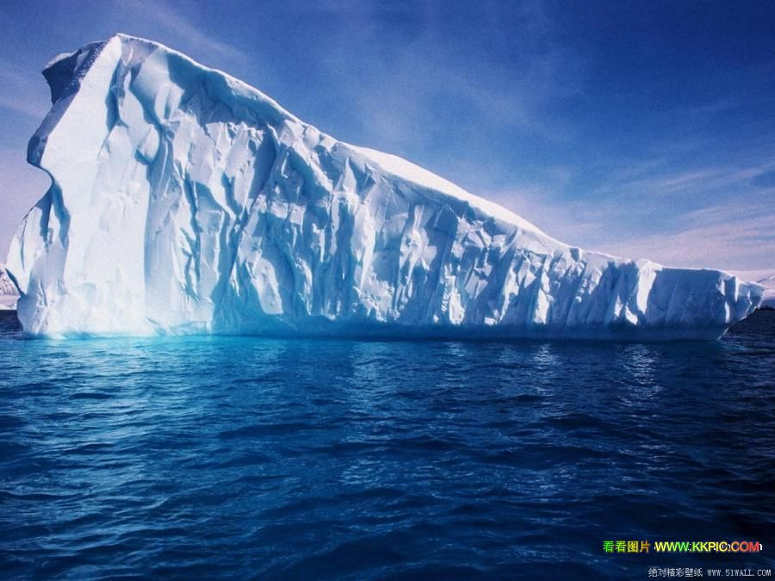
Module 1
Deep South
Reading and Vocabulary

Slide 2
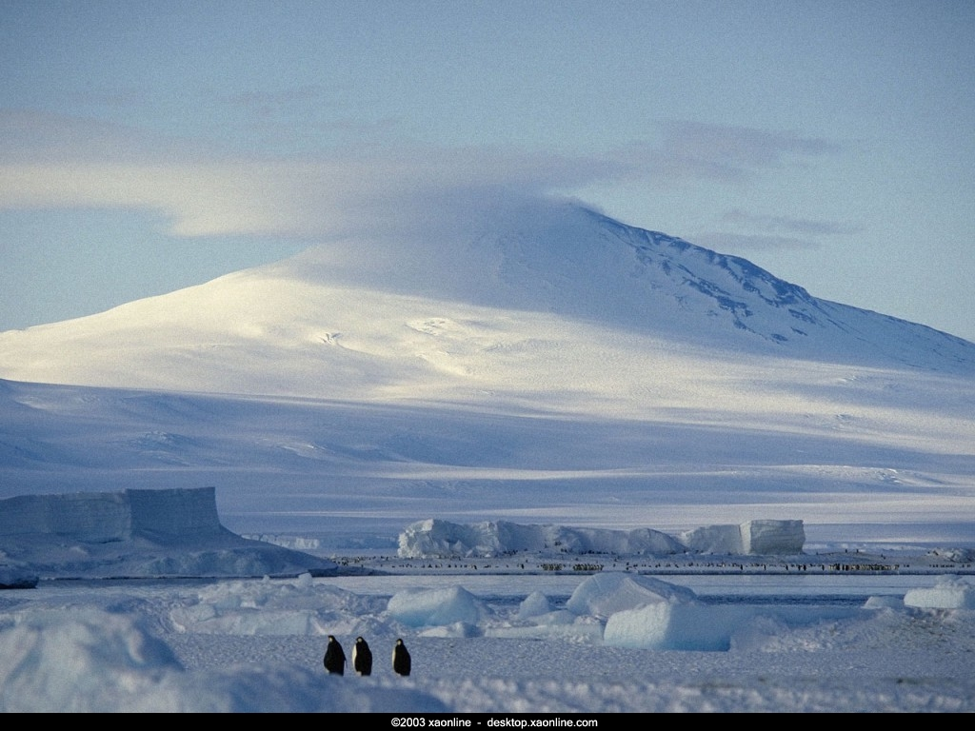
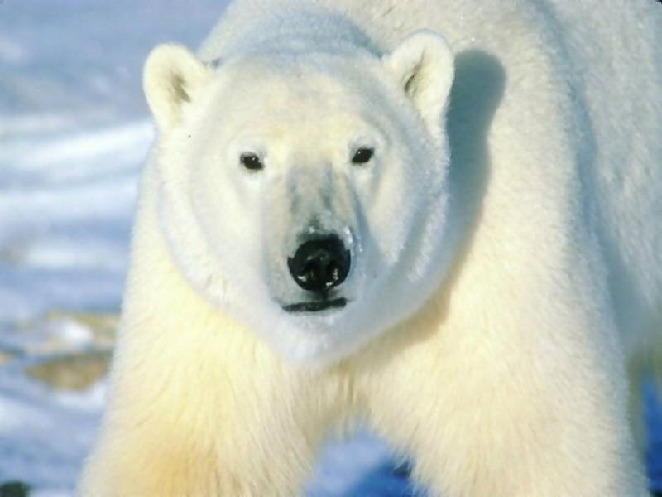
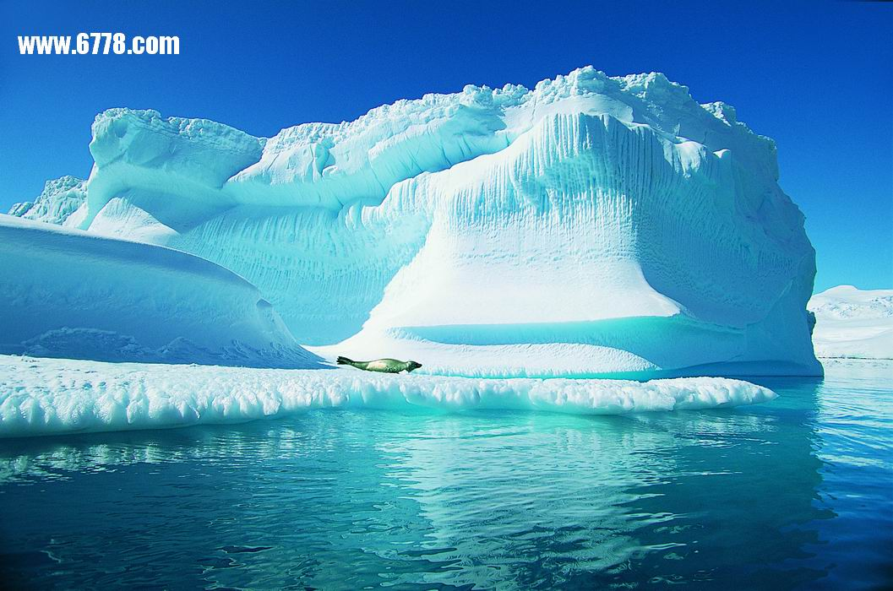
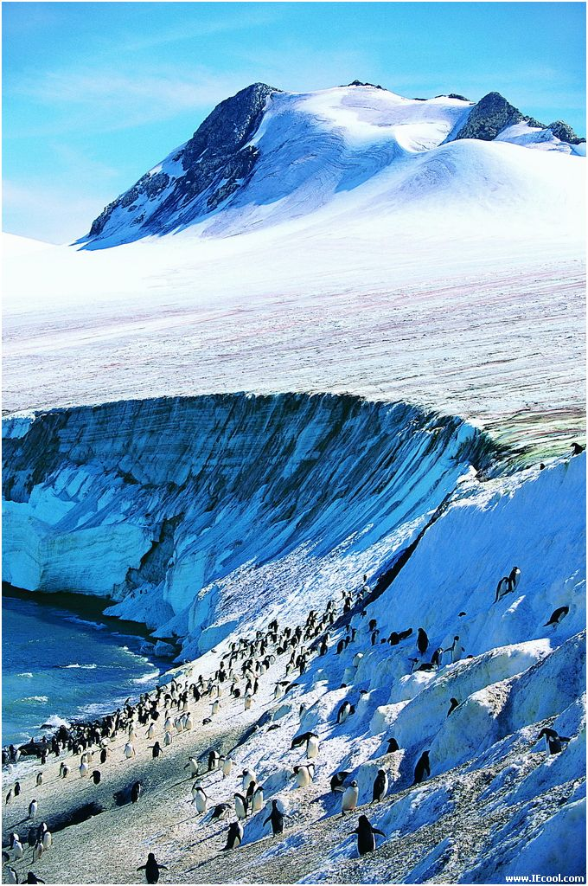
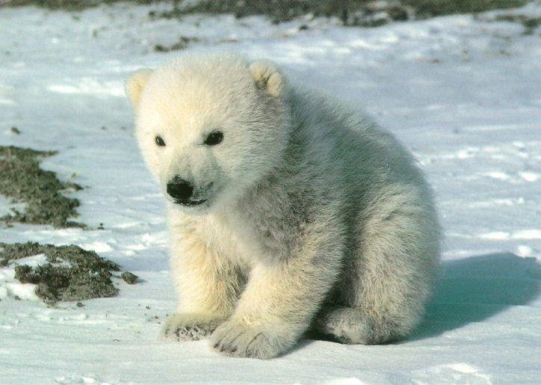
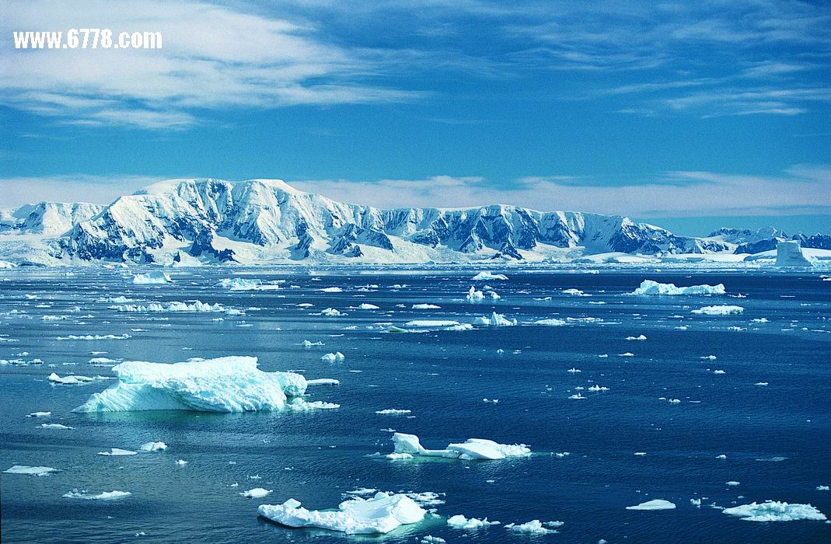
Introduction
North Polar Bear
North Polar Bear

Slide 3
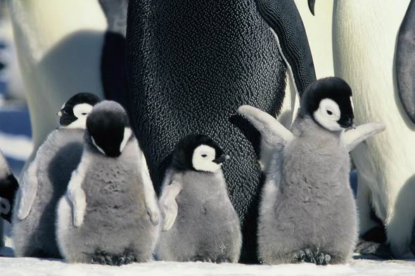
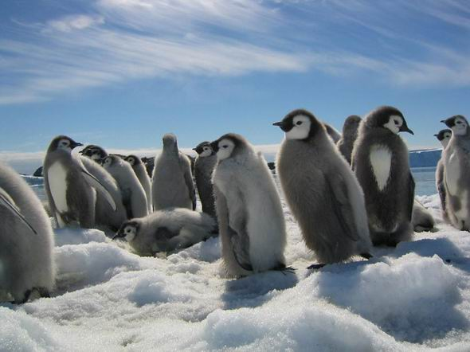

Slide 4
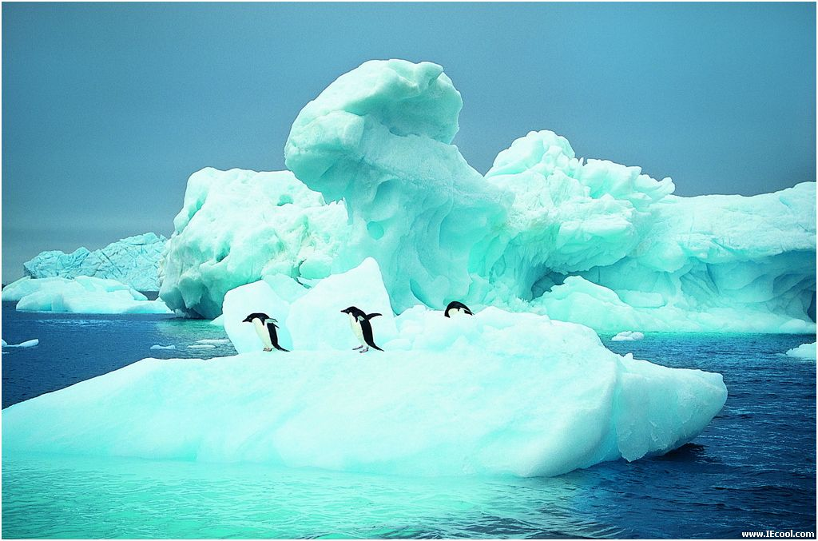
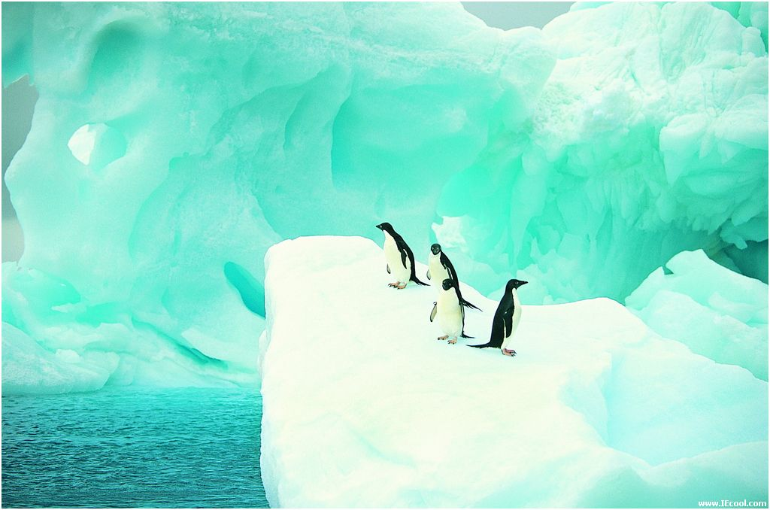
Penguins

Slide 5
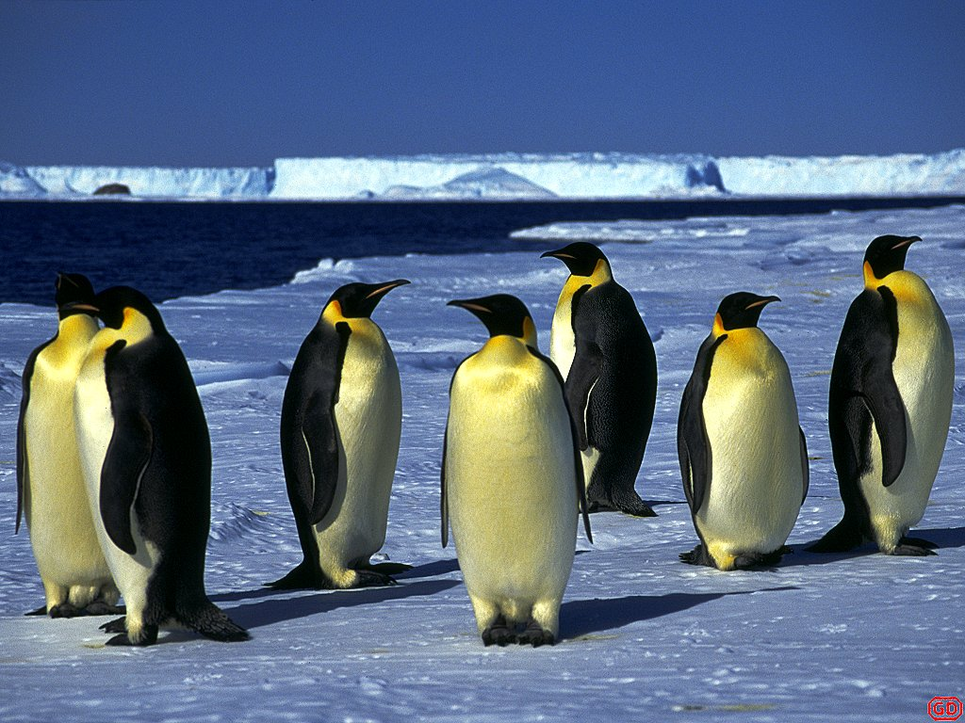
Are there penguins in the North Pole or the South Pole？

Slide 6
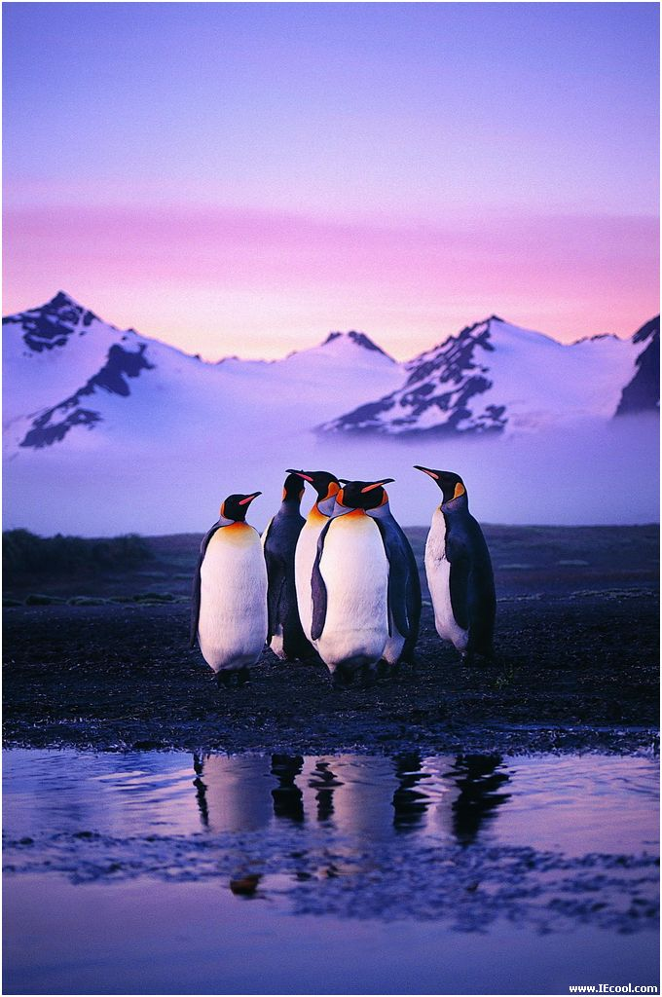
The South Poles

Slide 7
1. has no land.
2. has more ice.
3. has polar bears.
4. has penguins.
The North Pole
The South Pole
The North Pole
The South Pole

Slide 8
5. has the longest period of total darkness.
6. has no inhabitants.
7. was reach first by explorers.
8. is protected by an international agreement.
The South Pole
The South Pole
The North Pole
The South Pole

Slide 9
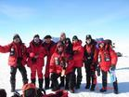
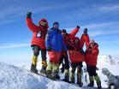
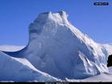
Do you know when the Chinese arrived
at the South Pole for the first time ?

Slide 10
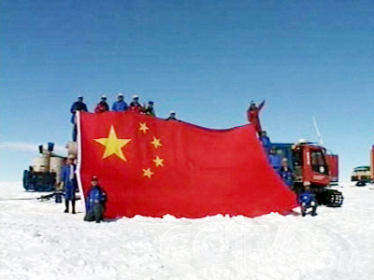
How many times have the Chinese
scientists have been to the South Pole?

Slide 11
中国第24次南极科学考察队2007年11月12日从中国极地考察国内基地码头启程，乘坐改装一新的“雪龙”号极地科学考察船，奔赴南极，执行中国 ２００７－２００８年度科学考察和后勤保障任务。

Slide 12
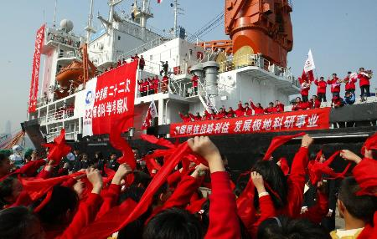

Slide 13
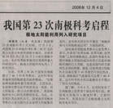

Slide 14
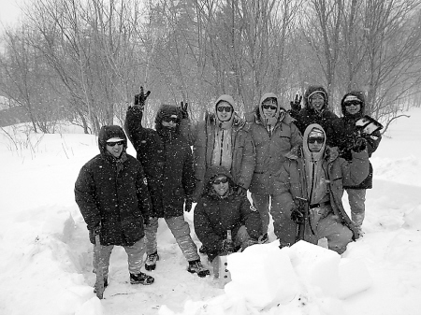
中国第24次南极科考队员在黑龙江亚布力进行集训时的情形

Slide 15
Word preview
Antarctica
annual
rainfall
state
depth
gravity
inhospitable
extreme
flower
n.南极洲
adj.每年的
n.降水量，降雨量
n.状态，状况
n.深度
n.重力，地心引力
adj.不宜居住的
adj.极端的，极度的
v.开花

Slide 16
moss
algae
lichen
adapt to
trap
meteorite
extraterrestrial
mass
balance
n.藓，苔藓
n.藻类(植物)
n.地衣
(使)适应
v.储存，留存
n.陨石
adj.地球外的
n.块，堆，团
v.使平衡

Slide 17
exploration
set foot on
rivalry
treaty
commercial
nuclear
test
radioactive
promote
n.勘查
进入，到达
n.(不断的)竞争
n.条约，公约
adj.商业的
adj.核的，核能的
n.试验
adj.放射性的
v.促进，增进

Slide 18
Words-guessing
1.a large area of land
2.all of the time
3.the ice covering the North or South Pole
continent
permanently
ice cap

Slide 19
4.unpleasant or difficult to stay
5.an area without a clear shape
6.an area of protected land
7.being in competition
inhospitable
mass
reserve
rivalry

Slide 20
Complete the sentences with words in the box.
adapt depth explore gravity mineral nuclear radioactive rainfall surface trap(v.) treaty

Slide 21
1.The ___________of something is the top or outside part of it.
2.If you __________ a place,you hope to discover something there.
3.If you ________ to a new situation,you change.
surface
explore
adapt

Slide 22
mineral
4.A ___________ is a substance that is formed naturally in the earth.
5.A ________ is a special written agreement between different place.
6.___________ is a force which makes things fall to earth.
7.___________ is a force which makes things fall to earth.
treaty
Rainfall
Gravity

Slide 23
trap
8. If you ______ something or someone, they can’t move.
9. _________ energy comes from the centre of an atom.
10. ________ means how deep something is.
11. ____________ refers to a dangerous form of nuclear energy.
Nuclear
Depth
Radioactive

Slide 24
Fast reading
1
A great place for researchers
Para 1
Para 2
Plants and animals
Para 3
The Antarctic Treaty
Para 4
The discovery of Antarctica
Para 5
The land

Slide 25
Antarctica
Para. 1 The land
Para. 2 Plants and Animals
Antarctica is an inhospitable place to live in because it is the coldest and the driest continent on earth and is permanently covered with ice.
As a result of its extreme conditions, only few types of plants can survive there, but it is full of wildlife.

Slide 26
Antarctic ice and rocks can give researchers lots of useful information.
Part 3 A great place for researchers
Part 4 The discovery of Antarctica
Part 5 The Antarctica Treaty
Antarctica was the last continent to be discovered and Carstens Borchgrevink was the first man to set foot on the Antarctic mainland.
The aim of the treaty signed by 12 countries is to protect Antarctica and Antarctica and it has become the most successful symbol of man’s efforts to work together for progress and peace.

Slide 27
Careful reading
Para. 1
What is the topic sentence of the first paragraph?
The topic sentence is Antarctic is the coldest place on Earth.

Slide 28
According to the first paragraph, fill in the blanks.
With annual rainfall____________(几乎为零), Antarctica is _________(根据确切意义上)a desert.
close to zero
technically
b. Antarctic _______(容纳)90% of the world’s ice and most of its fresh water is _______________(一种冰冻状态)
holds
in a frozen state

Slide 29
c. Strong winds __________(drive) by gravity blow from the pole to the coastline, _________(然而) other wind blow round the coast.
driven
while
d. There are mountain and volcanoes in Antarctica. (True or False)

Slide 30
Para. 2 Check the following sentences true or false.
a. Not many animals live there.
(F)
b. Only two types of flowering plants are found, while there are no trees on the large continent.
(T)
c. Some forms of algae and lichen.
(T)
What is the topic sentence?
Yet Antarctica is full of wildlife, which has adapted to its extreme conditions.

Slide 31
Para. 3 Check the following sentences true or false.
a. There are lots of white rocks in Antarctica.
(F)
b. Gases and minerals, in the form of volcanic dust trapped in the ice, can tell us a lot about what the world’s climate was like in past ages.
(T)

Slide 32
Translate the sentence into Chinese.
Antarctica has become perhaps the most successful symbol of man’s efforts to work together for progress and peace.
南极洲或许已经成为人类为了和平与发展而共同努力的最后成功的标志。

Slide 33
5
1. Paragraph 5, after“…the world’s biggest nature reserve.”
2. Paragraph 4, after“The race to the pole had begun.”
3. Paragraph 1, after“…a depth of five kilometers.”

Slide 34
4. Paragraph 3, after“Most of them are meteorites from outer space.”
5. Paragraph 2, after “There are different types of penguins, flying birds, seals and whales.”

Slide 35
Discussion
1.Why is Antarctica an important place?
It is a window on the past, and can give us lots of useful information.
2.Do you think the Antarctic Treaty is a good idea? Why/why not?
That is a good idea. The Antarctic can be protected very well.

Slide 36
3.What might happen to Antarctic if there wasn’t an international treaty to protect it?
It may be polluted and used for the aim of commercial and military using.
4.What other international treaties do you know about?
There are some new treaties recently, for example …

Slide 37
5.What other international treaties do you think the world needs?
There need more international treaties to protect our world such as the environmental and natural resource protection treaties.

Slide 38
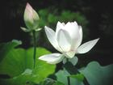
Thank you

